Slide 1
Resource Degradation and Rural Livelihood

Slide 3
This is what we will discuss on
The degradation of resources by the industries causes a great deal of difficulties for the rural livelihood.
We shall demonstrate the various ways in which resources belonging to the rural people are being degraded, and what kind of difficulty it lands them onto.

Slide 4
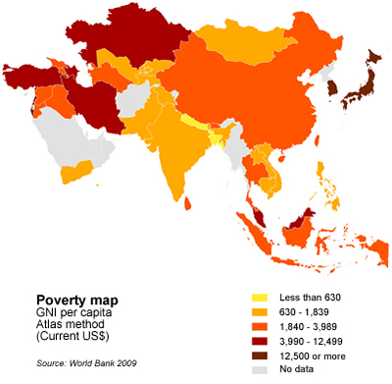

Slide 5
What Industrials think about the Rural People?
Rural people don’t even own the places & resources even if they have been living there for generations.
If they don’t own or buy then they don’t have value.
Throw them out of their area so that the only way out for them is to work as workers in industries.

Slide 6
Facts
Around 200,000 people a day migrate to the cities for work, globally.
Kids in Congo pay with their future. They are made to work in factories.
Women of reproductive age, who work in the industries are exposed to reproductive toxins, etc. none care of their health,
80% of planet’s original forestry is gone. 2000 trees a minute. 7 footballs fields.
40% of US waterways have become undrinkable.
In the past three decades alone one-thirds of the planets natural resources been consumed.
In the US they have less than 4% of forests left.

Slide 7
What is resource degradation?
We use up various resources everyday, but don’t bother think that they are not being properly used. Trees are being cut down at an astonishing rate 200,000 per day, globally. And who bothers to plant them back.
Petroleum is being sucked up at tremendous rates all over the world, and much of it has been used up already. Most of the coal has already been mined out with only a few still left out; And still the industries are worried why that bit is still left and not being put to use.
They are probably not able to realise that it takes millions of years to form coal and petroleum. Once finish it all up then it won't be possible to get it back any more until a million years later.
Who knows, there may be several better ways of using coal and petroleum, than using it as a fuel. Petroleum chemicals often form the base for production of any organic chemical.
All petroleum chemicals have a carbon skeleton which is used by organic chemists and organic product industries to produce different organic chemicals. every time an organic chemist earns a Nobel prize due to discovery of organic chemicals, its starting lies in petroleum.

Slide 8
Where does our trash go?
We love to buy a lot of stuff. The prime cause of our happiness lies in owning more and more stuff.
We keep buying and buying things everyday, yet our houses never get filled. Can anyone ever reason how such an occurrence is ever possible.
Yes\No. Its because we trash most of them. about 99% of the products that we buy in six months end up in garbage form.
And where does it all end up? It ends up mostly in the natural dustbins available to us. The rural villages.
Yes, it the same place from where we extract resources, double damage. All the shining promises of reusing and recycling by the big companies now begin to look more dull. In such a form it causes pollution to the environment.

Slide 9
Affect on Rural People
All over the world rural people are the ones who are most ignored. Much of the resources that are used by the industries are extracted from places where the rural people live.
However, it does not matter to the industrialists whether anyone lives there or not. They just slash down the trees, bomb down the mountains, turn forests into ghost-tows(mine fields) to dig out metals, use up all the water; pollute it, and sweep out the animals.
This leaves the rural people with nothing other than the same nothing. They are not valued at all even though they have been living there for generations.
Left out with no other means of living, the rural people are forced to move out to the cities, for working in the industries and living in very unhealthy conditions in the slums which circle around the city.
This way the industries have a constant supply of workers, which is an added benefit to those guys. There the rural people have to now be exposed to various toxins. What a bad life?

